Slide 1


Lecture – linked list data structure & algorithms
Mr. muhammad saleem
lecturer
Department of Computer Science
Dawood University of Engineering and Technology, Karachi

Slide 2
Contents
Introduction of Linked List
Uses of Linked List
Limitation of Array Linked list can Over Come
Linked List Memory Representation
Type of Linked List
Singly
Doubly
Circular

Slide 3
Linked list
Linked List can be defined as collection of objects called nodes that are randomly stored in the memory.
A node contains two fields i.e. data stored at that particular address and the pointer which contains the address of the next node in the memory.
The last node of the list contains pointer to the null.

Slide 4
Uses of Linked List
The list is not required to be contiguously present in the memory. The node can reside any where in the memory and linked together to make a list.
This achieves optimized utilization of space.
list size is limited to the memory size and doesn't need to be declared in advance.
Empty node can not be present in the linked list.
We can store values of primitive types or objects in the singly linked list.

Slide 5
Array contains following limitations:
The size of array must be known in advance before using it in the program.
Increasing size of the array is a time taking process. It is almost impossible to expand the size of the array at run time.
All the elements in the array need to be contiguously stored in the memory. Inserting any element in the array needs shifting of all its predecessors.

Slide 6
Linked list overcomes the limitations of array
It allocates the memory dynamically.
All the nodes of linked list are non-contiguously stored in the memory and linked together with the help of pointers.
Sizing is no longer a problem since we do not need to define its size at the time of declaration. List grows as per the program's demand and limited to the available memory space.

Slide 7
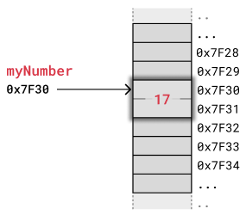
Simple variable memory representation
Computer memory is the storage your program uses when it is running.
This is where your variables, arrays and linked lists are stored.
The image fig 1.1 shows how the variable myNumber = 17 is stored in memory.

Slide 8
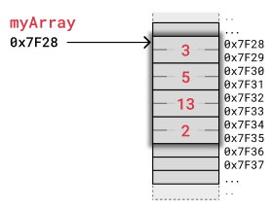
Array memory representation
The image below shows how an array of integers myArray = [3,5,13,2] is stored in memory.
We use a simple kind of memory here with two bytes for each integer, like in the previous example, just to get the idea.

Slide 9
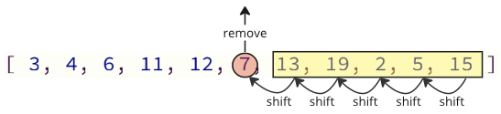
Array memory representation
When removing or inserting elements in an array, every element that comes after must be either shifted up to make place for the new element, or shifted down to take the removed element's place.
Such shifting operations are time consuming and can cause problems in real-time systems for example.
The image below shows how elements are shifted when an array element is removed.

Slide 10
Linked list in memory
Instead of storing a collection of data as an array, we can create a linked list.
Linked lists are used in many scenarios,
like dynamic data storage,
stack and queue implementation or graph representation, to mention some of them.
A big benefit with using linked lists is that nodes are stored wherever there is free space in memory, the nodes do not have to be stored contiguously right after each other like elements are stored in arrays.
Another nice thing with linked lists is that when adding or removing nodes, the rest of the nodes in the list do not have to be shifted.

Slide 11
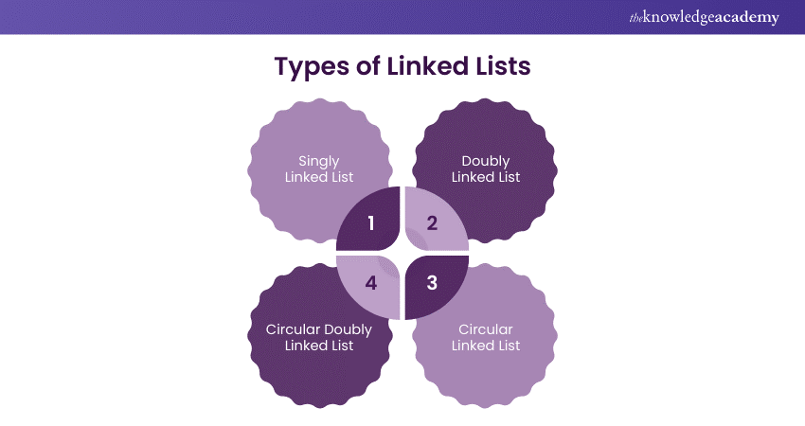

Slide 12
Singly linked list
A singly linked list is the simplest kind of linked lists. It takes up less space in memory because each node has only one address to the next node, like in the image below.

Slide 13
Singly linked list operations
Look Up
By Value O(n)
By Index O(n)
Insertion
At the end O(1)
At the beginning O(1)
At the Middle O(n)

Slide 14
Insertion into the beginning of the list
Tail
Head

Slide 15
Insertion into the beginning of the list
Tail
Head
New Node
Time Complexity O(1)

Slide 16
inserting at the end of the list
Tail
Head
New Node
Time Complexity O(1)

Slide 17
inserting at the middle of the list
Tail
Head
New Node
Time Complexity O(n)

Slide 18
Deletion operation
From the Beginning
O(1)
From the End
O(n)
From The Middle
O(n)

Slide 19
Deleting from the end of the list
Tail
Head
Time Complexity O(n)

Slide 20
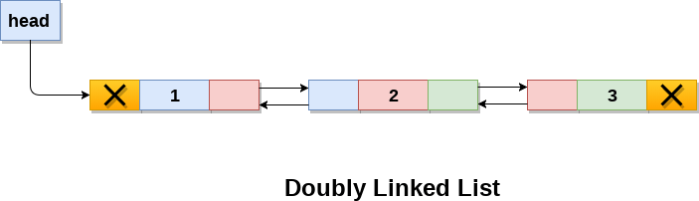
Doubly linked list
A doubly linked list has nodes with addresses to both the previous and the next node, like in the image below, and therefore takes up more memory.
But doubly linked lists are good if you want to be able to move both up and down in the list.

Slide 21
Doubly linked list
In a singly linked list, we could traverse only in one direction, because each node contains address of the next node and it doesn't have any record of its previous nodes.
However, doubly linked list overcome this limitation of singly linked list.
Due to the fact that, each node of the list contains the address of its previous node, we can find all the details about the previous node as well by using the previous address stored inside the previous part of each node.

Slide 22
Memory Representation of a doubly linked list
Memory Representation of a doubly linked list is shown in the following image. Generally, doubly linked list consumes more space for every node and therefore, causes more expansive basic operations such as insertion and deletion. However, we can easily manipulate the elements of the list since the list maintains pointers in both the directions (forward and backward).
In the following image, the first element of the list that is i.e. 13 stored at address 1. The head pointer points to the starting address 1. Since this is the first element being added to the list therefore the prev of the list contains null. The next node of the list resides at address 4 therefore the first node contains 4 in its next pointer.
We can traverse the list in this way until we find any node containing null or -1 in its next part.

Slide 23
Circular linked list
A circular linked list is like a singly or doubly linked list with the first node, the "head", and the last node, the "tail", connected.
In singly or doubly linked lists, we can find the start and end of a list by just checking if the links are null. But for circular linked lists, more complex code is needed to explicitly check for start and end nodes in certain applications.
Circular linked lists are good for lists you need to cycle through continuously.
The image below is an example of a singly circular linked list:

Slide 24
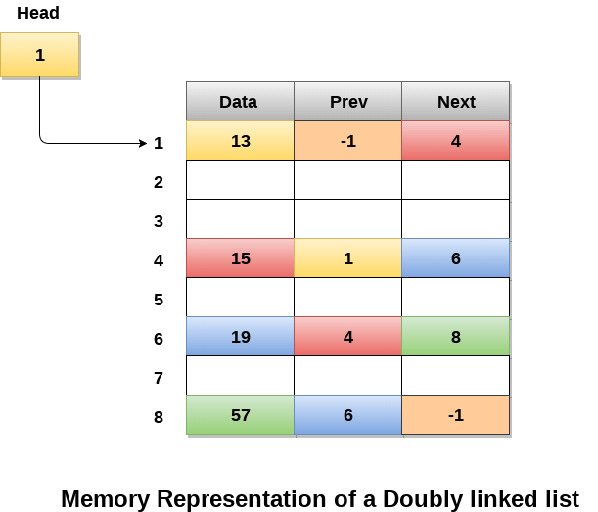

Slide 25
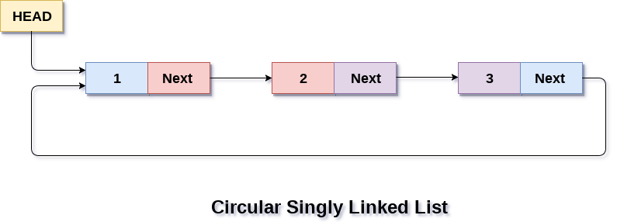
Circular linked list
A circular linked list is like a singly or doubly linked list with the first node, the "head", and the last node, the "tail", connected.
In singly or doubly linked lists, we can find the start and end of a list by just checking if the links are null. But for circular linked lists, more complex code is needed to explicitly check for start and end nodes in certain applications.
Circular linked lists are good for lists you need to cycle through continuously.
The image below is an example of a singly circular linked list:

Slide 26
Circular linked list uses
Circular linked list are mostly used in task maintenance in operating systems. There are many examples where circular linked list are being used in computer science including browser surfing where a record of pages visited in the past by the user, is maintained in the form of circular linked lists and can be accessed again on clicking the previous button.

Slide 27
Memory Representation of circular linked list
In the image on the next slide, memory representation of a circular linked list containing marks of a student in 4 subjects. However, the image shows a glimpse of how the circular list is being stored in the memory.
The start or head of the list is pointing to the element with the index 1 and containing 13 marks in the data part and 4 in the next part. Which means that it is linked with the node that is being stored at 4th index of the list.
However, due to the fact that we are considering circular linked list in the memory therefore the last node of the list contains the address of the first node of the list.

Slide 28
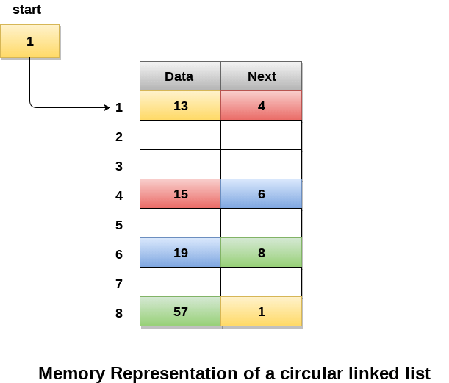

Slide 29
Building a linked list
addFirst()
addLast()
deleteFirst()
deleteLast()
contains()
indexOf()

Slide 30

Thanks!
For The Time & Attention
Do You Have Any Question?
Msaleem.jcb@gmail.com
+923333217216
For more information: https://www.javatpoint.com/data-structure-tutorial

